Slide 1

IMPLEMENTAREA CONCURENTEI IN LIMBAJE DE PROGRAMARE
Ioana Leustean
INTRODUCERE IN
ERLANG
http://www.erlang.org/

Slide 2
Bibliografie
Joe Armstrong, Programming Erlang, Second Edition 2013
Fred Hébert, Learn You Some Erlang For Great Good, 2013
Varianta online

Slide 3

ACTOR MODEL
"Erlang's actor model can be imagined as a world where everyone is sitting alone in their own room and can perform a few distinct tasks. Everyone communicates strictly by writing letters and that's it. While it sounds like a boring life (and a new age for the postal service), it means you can ask many people to perform very specific tasks for you, and none of them will ever do something wrong or make mistakes which will have repercussions on the work of others; they may not even know the existence of people other than you (and that's great).
To escape this analogy, Erlang forces you to write actors (processes) that will share no information with other bits of code unless they pass messages to each other. Every communication is explicit, traceable and safe."
Varianta online
Fred Hébert, Learn You Some Erlang For Great Good
http://learnyousomeerlang.com/introduction#what-is-erlang

Slide 4
Modelul Actori
Introdus de Carl Hewitt in 1973
Actorii sunt o notiune abstracta (corespunzatoare proceselor)
Actorii au memorie proprie, NU au memorie partajata
Actorii comunica prin mesaje
Un actor este capabil sa:
trimita mesaje actorilor pe care ii cunoaste
creeze noi actori
raspunda mesajelor pe care le primeste
Mesajele contin un destinatar si un continut
Trimiterea mesajelor este asincrona

Slide 5
Concurenta in Erlang este implementata folosind urmatoarele primitive:
Pid = spawn (fun)
Pid = spawn (module, fct, args)
Pid ! Message
receive … end
receive … after … end

Slide 6
receive … after … end
La intrarea in receive, daca exista un after, se porneste un timer.
Mesajele din coada sunt investigate in ordinea sosirii; daca un mesaj se potriveste cu un pattern atunci expresia corespunzatoare este prelucrata.
Mesajele care nu se potrivesc cu nici un pattern sunt puse intr-o coada separate (save queue).
Daca nu mai sunt mesaje in coada procesul se suspenda si asteapta venirea unui nou mesaj; la venirea acestuia, numai el este prelucrat, nu si mesajele din save queue.
Cand un mesaj se potriveste cu un pattern, mesajele din save queue sunt puse la loc in coada si timerul se sterge.
Daca timpul T s-a scurs fara ca un mesaj sa se potriveasca unui pattern, atunci ExpressionT se executa, iar mesajele din save queue sunt puse inapoi in coada.
receive
Pattern1 when Guard1 -> Expr1;
Pattern2 when Guard2 -> Expr2;
Pattern3 -> Expr3
…
after T ->
ExpressionT
end

Slide 7
Modelul client-server cu transmiterea starii
Functia start(stare) porneste serverul (proces inregistrat)
Comenzile client: store, take, show, terminate
start(FoodList) -> register(fridge, spawn(fun()-> fridgef(FoodList) end)).
fridgef(FoodList) ->
receive
% comanda store
% comanda take
….
end.
store(Food) ->
fridge! {self(), {store, Food}},
receive
{fridge, Msg} -> Msg
end.
take( Food) ->
fridge ! {self(), {take, Food}},
receive
{fridge, Msg} -> Msg
end.
show() ->
fridge ! {self(), show},
receive
{fridge, Msg} -> Msg
end.
terminate() ->
fridge ! {self(), terminate},
receive
{fridge, Msg} -> Msg
end.

Slide 8
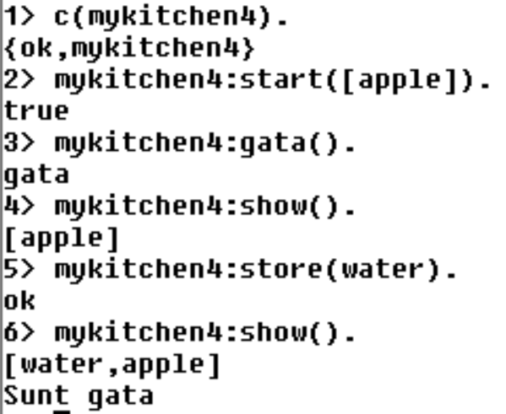
receive … after … end
fridgef(FoodList) ->
receive
{From, {store, Food}} -> From ! {fridge, ok},
fridgef([Food|FoodList]);
{From, {take, Food}} ->
case lists:member(Food, FoodList) of
true -> From ! {fridge, {ok, Food}},
fridgef(lists:delete(Food, FoodList));
false -> From ! {fridge, not_found},
fridgef(FoodList)
end;
{From,show} -> From ! {fridge, FoodList},
fridgef(FoodList);
{From,terminate} -> From ! {fridge, done}
after 30000 -> timeout
end,
receive
gata -> io:format("Sunt gata~n")
end.
functia gata() intoarce imediat,
shell-ul nu ramane blocat
se pot trimite mesaje serverului
mesajul gata este prelucrat dupa ce au trec 30 sec
fara o comanda prelucrata de primul receive
gata() -> fridge ! gata

Slide 9
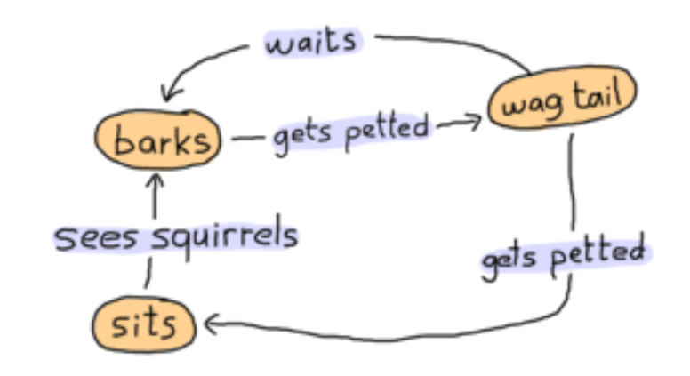
Implementarea unui automat finit
(Finite-State Machine)
Starile ={barks, sits, wag_tail}
Actiunile ={gets_petted, see_squirrels, waits}
dog as a state-machine
http://learnyousomeerlang.com/finite-state-machines#what-are-they

Slide 10

Implementarea unui automat finit
-module(dog_fsm).
-export([start/0, squirrel/1, pet/1]).
start() ->
spawn(fun() -> bark() end). % starea initiala
%actiunea see_squirrels
squirrel(Pid) -> Pid ! squirrel.
%actiunea gets_petted
pet(Pid) -> Pid ! pet.
actiunile sunt implementate prin mesaje si
sunt vizibile in exterior

Slide 11
Finite-StateMachine: implementarea starilor
bark() ->
io:format("Dog says: BARK! BARK!~n"),
receive
pet -> wag_tail();
_ -> io:format("Dog is confused~n"),
bark()
after 2000 -> bark()
end.

Slide 12
Automat finit: definirea starilor
wag_tail() ->
io:format("Dog wags its tail~n"),
receive
pet -> sit();
_ -> io:format("Dog is confused~n"),
wag_tail()
after 30000 ->
bark() % actiunea waits
end.

Slide 13
Automat finit: definirea starilor
sit() ->
io:format("Dog is sitting. Gooooood boy!~n"),
receive
squirrel -> bark();
_ -> io:format("Dog is confused~n"),
sit()
end.

Slide 14
Implementarea unui automat finit
http://learnyousomeerlang.com/finite-state-machines#what-are-they

Slide 15
Tratarea erorilor
Error handling in concurrent Erlang programs is based on the idea of remote
detection and handling of errors. Instead of handling an error in the process
where the error occurs, we let the process die and correct the error in some
other process."
Joe Armstrong, Programming Erlang, Second Edition 2013
OTP
OTP stands for Open Telecom Platform, although it's not that much about telecom anymore (it's more about software that has the property of telecom applications, but yeah.) If half of Erlang's greatness comes from its concurrency and distribution and the other half comes from its error handling capabilities, then the OTP framework is the third half of it.
http://learnyousomeerlang.com/what-is-otp#its-the-open-telecom-platform

Slide 16
Erori in progamarea concurenta
"Imagine a system with only one sequential process. If this process dies, we
might be in deep trouble since no other process can help. For this reason,
sequential languages have concentrated on the prevention of failure and an
emphasis on defensive programming.
Error handling in concurrent Erlang programs is based on the idea of remote
detection and handling of errors. Instead of handling an error in the process
where the error occurs, we let the process die and correct the error in some
other process."
Joe Armstrong, Programming Erlang, Second Edition 2013

Slide 17
Erori in progamarea concurenta
"When we design a fault-tolerant system, we assume that errors will occur,
that processes will crash, and that machines will fail. Our job is to detect the
errors after they have occurred and correct them if possible.
The Erlang philosophy for building fault-tolerant software can be summed
up in two easy-to-remember phrases: “Let some other process fix the error”
and “Let it crash.”
Joe Armstrong, Programming Erlang, Second Edition 2013

Slide 18
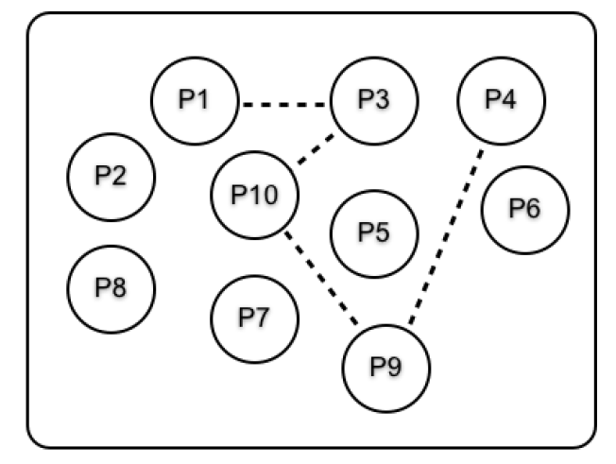
Erori in programarea concurenta
procesele pot fi legate, iar legatura intre procese se creaza cu functia
legatura create cu link este bidirectionala
cand un proces se termina, el trimite un semnal de eroare
tuturor proceselor legate de el
link(Pid)
Joe Armstrong, Programming Erlang, Second Edition 2013

Slide 19
Mesaje si semnale de eroare
procesele comunica prin mesaje si semnale de eroare
mesajele sunt trimise cu ! (send)
cand un process se termina, el emite un exit reason
daca un proces se termina normal, reason este atomul normal
daca un process se termina cu eroare (la runtime), reason este {Reason, Stack}
un proces se poate termina singur prin apelul functiei exit
cand un proces se termina (normal sau cu eroarea) trimite automat
un semnal tuturor proceselor de care este legat

Slide 20
Mesaje si semnale de eroare
procesele comunica prin mesaje si semnale de eroare
mesajele sunt trimise cu !
cand un process se termina, el emite un exit reason
cand un proces se termina (normal sau cu eroarea) trimite automat
un semnal tuturor proceselor de care este legat
exit/1 exit/2
un process se poate termina singur prin apelul functiei exit(reason) ; in acest caz
el va trimite un semnal de eroare tuturor mesajelor de care este legat
un proces poate trimite un semnal de eroare fals apeland
exit(Pid, Reason); in acest caz, Pid va primi semnalul de eroare dar procesul initial nu se termina.

Slide 21
Procese normale si procese sistem
exista doua tipuri de procese: procese normale si procese system
un process normal devine process system prin evaluarea expresiei
process_flag(trap_exit,true)
Primirea semnalelor de eroare
Cand un proces normal primeste un semnal de eroare si exit reason nu este normal atunci procesul se termina si trimite semnalul de eroare proceselor cu care este legat.
Joe Armstrong, Programming Erlang, Second Edition 2013

Slide 22
Primirea semnalelor de eroare
process_flag(trap_exit,true)
-- trap the exit signals
Cand un proces sistem primeste un semnal de eroare, il transforma intr-un mesaj de forma
{'EXIT', Pid, Why}
Unde Pid este identitatea procesului care s-a terminat si Why este exit reason (cand procesul nu se termina cu eroare, Why este normal)
Procesele sistem opresc propagarea erorilor.
Daca un proces system pimeste mesajul kill atunci se termina. Mesajele kill sunt generate prin apeluri exit(Pid, kill)
Joe Armstrong, Programming Erlang,
Second Edition 2013

Slide 23
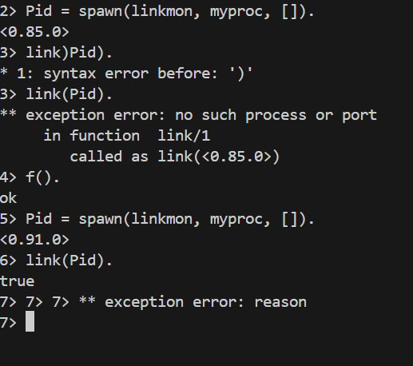
link() si spawn_link()
myproc() ->
timer:sleep(5000),
exit(reason).
procesul s-a terminat inainte de a face legatura
Joe Armstrong, Programming Erlang, Second Edition 2013

Slide 24
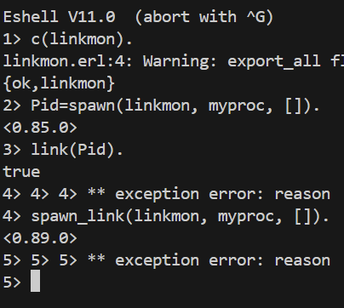
link() si spawn_link()
myproc() ->
timer:sleep(5000),
exit(reason).
Joe Armstrong, Programming Erlang, Second Edition 2013
spawn_link (Module, Function, [arguments])

Slide 25
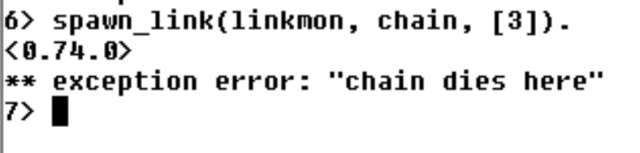
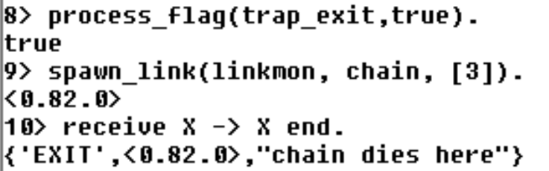
Un grup de procese care mor impreuna
chain(0) ->
receive
_ -> ok
after 2000 ->
exit("chain dies here")
end;
chain(N) ->
Pid = spawn(fun() -> chain(N-1) end),
link(Pid),
receive
_ -> ok
end.
Fred Hébert, Learn You Some Erlang For Great Good, 2013

Slide 26
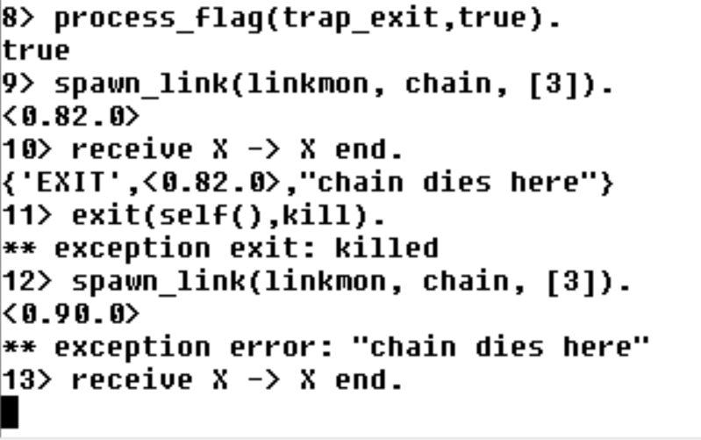
Shell-ul este process sistem
Shell-ul nu este process sistem

Slide 27
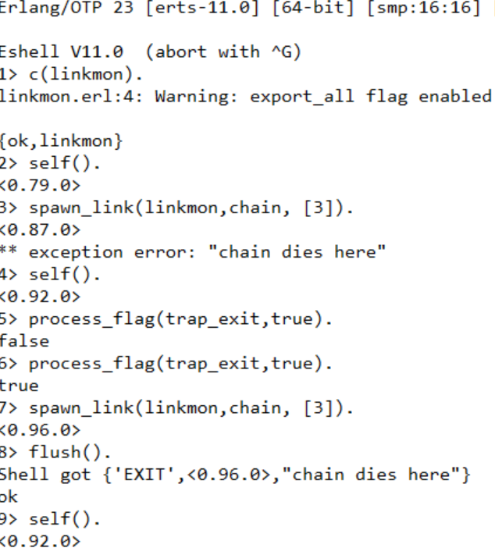
pentru efectuarea comenzilor,
shell-ul foloseste un proces evaluator
la aparitia unei exceptii,
procesul evaluator curent se termina,
iar shell-ul creaza un nou process evaluator
procesul evaluator initial
exceptie
proces evaluator nou
Erlang -- shell

Slide 28
Exemplu server-client
server (critic)
start_critic() ->
spawn(?MODULE, critic, []).
critic() ->
receive
{From, {"Rage Against the Turing Machine", "Unit Testify"}} ->
From ! {self(), "They are great!"};
{From, {"System of a Downtime", "Memoize"}} ->
From ! {self(), "They're not Johnny Crash but they're good."};
{From, {"Johnny Crash", "The Token Ring of Fire"}} ->
From ! {self(), "Simply incredible."};
{From, {_Band, _Album}} ->
From ! {self(), "They are terrible!"}
end,
critic().
client (judge)
judge(Pid, Band, Album) ->
Pid ! {self(), {Band, Album}},
receive
{Pid, Criticism} -> Criticism
after 2000 ->
timeout
end.
linkmon.erl
http://learnyousomeerlang.com/errors-and-processes

Slide 29
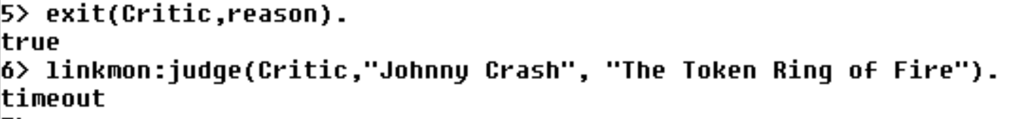
judge(Pid, Band, Album) ->
Pid ! {self(), {Band, Album}},
receive
{Pid, Criticism} -> Criticism
after 2000 ->
timeout
end.
linkmon.erl
http://learnyousomeerlang.com/errors-and-processes

Slide 30
Proces sistem supervisor (restarter)
restarter/supervizor
start_critic1() ->
spawn(?MODULE, restarter, []).
restarter() ->
process_flag(trap_exit, true),
Pid = spawn_link(?MODULE, critic, []),
register(critic, Pid),
receive
{'EXIT', Pid, normal} -> % not a crash
ok;
{'EXIT', Pid, shutdown} -> % manual termination
ok;
{'EXIT', Pid, _} ->
restarter()
end.
server
critic() ->
…..
client
judge1(Band, Album) ->
critic ! {self(), {Band, Album}},
Pid = whereis(critic),
receive
{Pid, Criticism} -> Criticism
after 2000 ->
timeout
end.
http://learnyousomeerlang.com/errors-and-processes

Slide 31
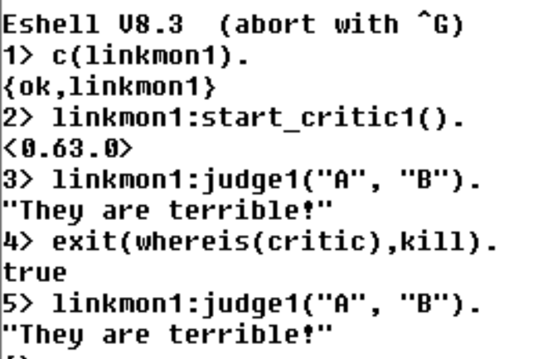
Serverul este repornit
server
critic() ->
…..
client
judge1(Band, Album) ->
……
supervizor
start_critic1() ->
spawn(?MODULE, restarter, []).
restarter() ->
process_flag(trap_exit, true),
…..
end.
serverul moare
serverul este repornit de supervizor

Slide 32
server
supervizor
critic() ->
…..
start_critic1() ->
spawn(?MODULE, restarter, []).
restarter() ->
process_flag(trap_exit, true),
Pid = spawn_link(?MODULE, critic, []),
register(critic, Pid),
receive
{'EXIT', Pid, normal} -> % not a crash
ok;
{'EXIT', Pid, shutdown} -> % manual termination, not a crash
ok;
{'EXIT', Pid, _} ->
restarter()
end.
client
judge1(Band, Album) ->
critic ! {self(), {Band, Album}},
Pid = whereis(critic),
receive
{Pid, Criticism} -> Criticism
after 2000 ->
timeout
end.
data race!
http://learnyousomeerlang.com/errors-and-processes

Slide 33
critic2() ->
receive
{From, Ref, {"Rage Against the Turing Machine", "Unit Testify"}} ->
From ! {Ref, "They are great!"};
{From, Ref, {"System of a Downtime", "Memoize"}} ->
From ! {Ref, "They're not Johnny Crash but they're good."};
{From, Ref, {"Johnny Crash", "The Token Ring of Fire"}} ->
From ! {Ref, "Simply incredible."};
{From, Ref, {_Band, _Album}} ->
From ! {Ref, "They are terrible!"}
end,
critic2().
judge2(Band, Album) ->
Ref = make_ref(),
critic ! {self(), Ref, {Band, Album}},
receive
{Ref, Criticism} -> Criticism
after 2000 ->
timeout
end.
Data type: reference
A reference is a term that is unique in an Erlang runtime system,
created by calling make_ref/0.
http://erlang.org/doc/reference_manual/data_types.html#id67845
linkmon.erl
http://learnyousomeerlang.com/errors-and-processes

Slide 34
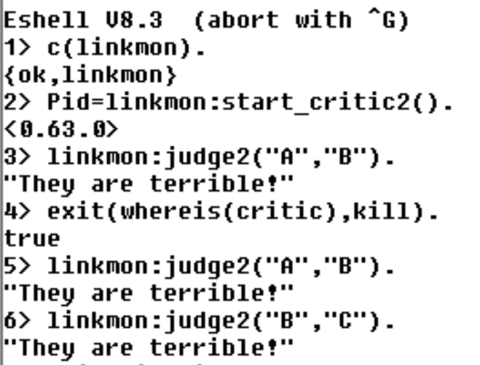
start_critic2() ->
spawn(?MODULE, restarter, []).
restarter() ->
process_flag(trap_exit, true),
Pid = spawn_link(?MODULE, critic2, []),
register(critic, Pid),
receive
{'EXIT', Pid, normal} -> % not a crash
ok;
{'EXIT', Pid, shutdown} -> % manual termination, not a crash
ok;
{'EXIT', Pid, _} ->
restarter()
end.

Slide 35
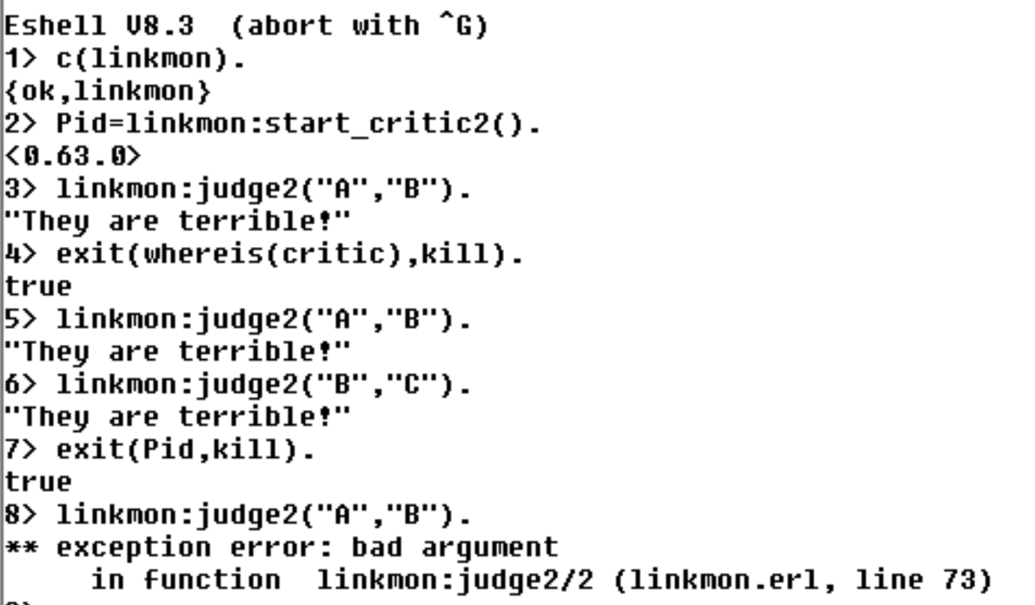

Slide 36
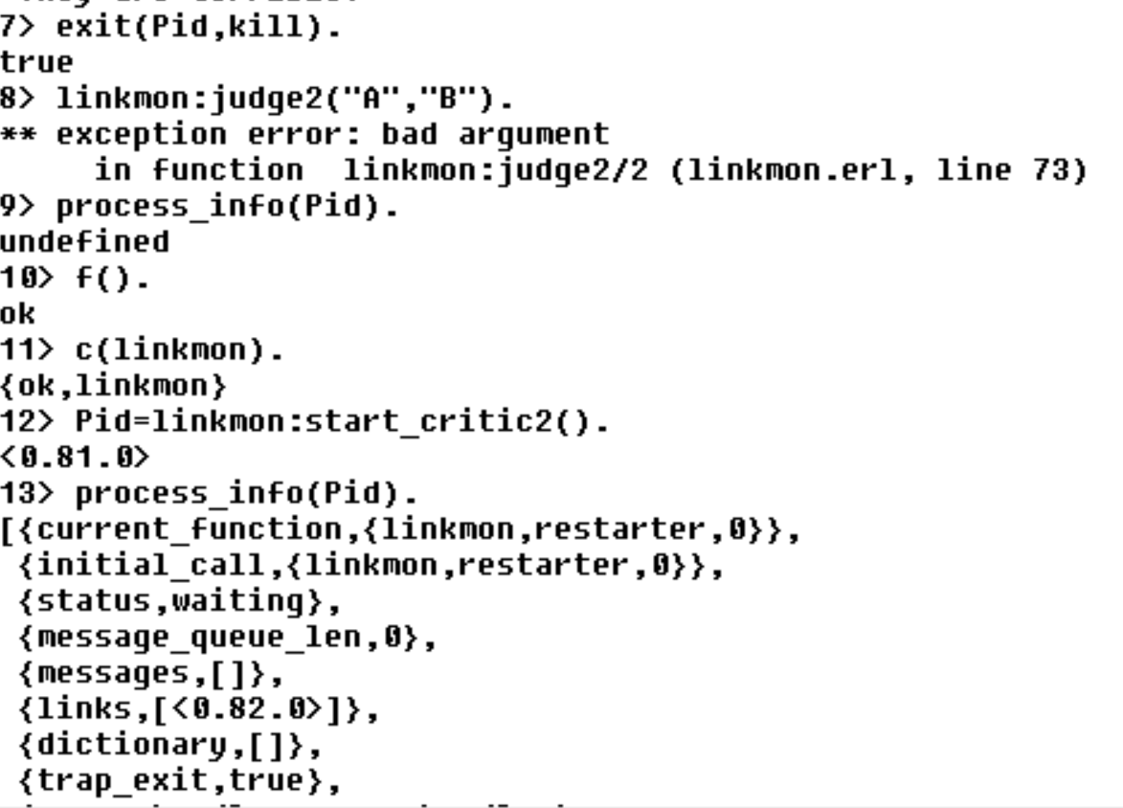
process_info (Pid)
returneaza o lista de informatii sau
undefined daca procesul nu exista

